Slide 1
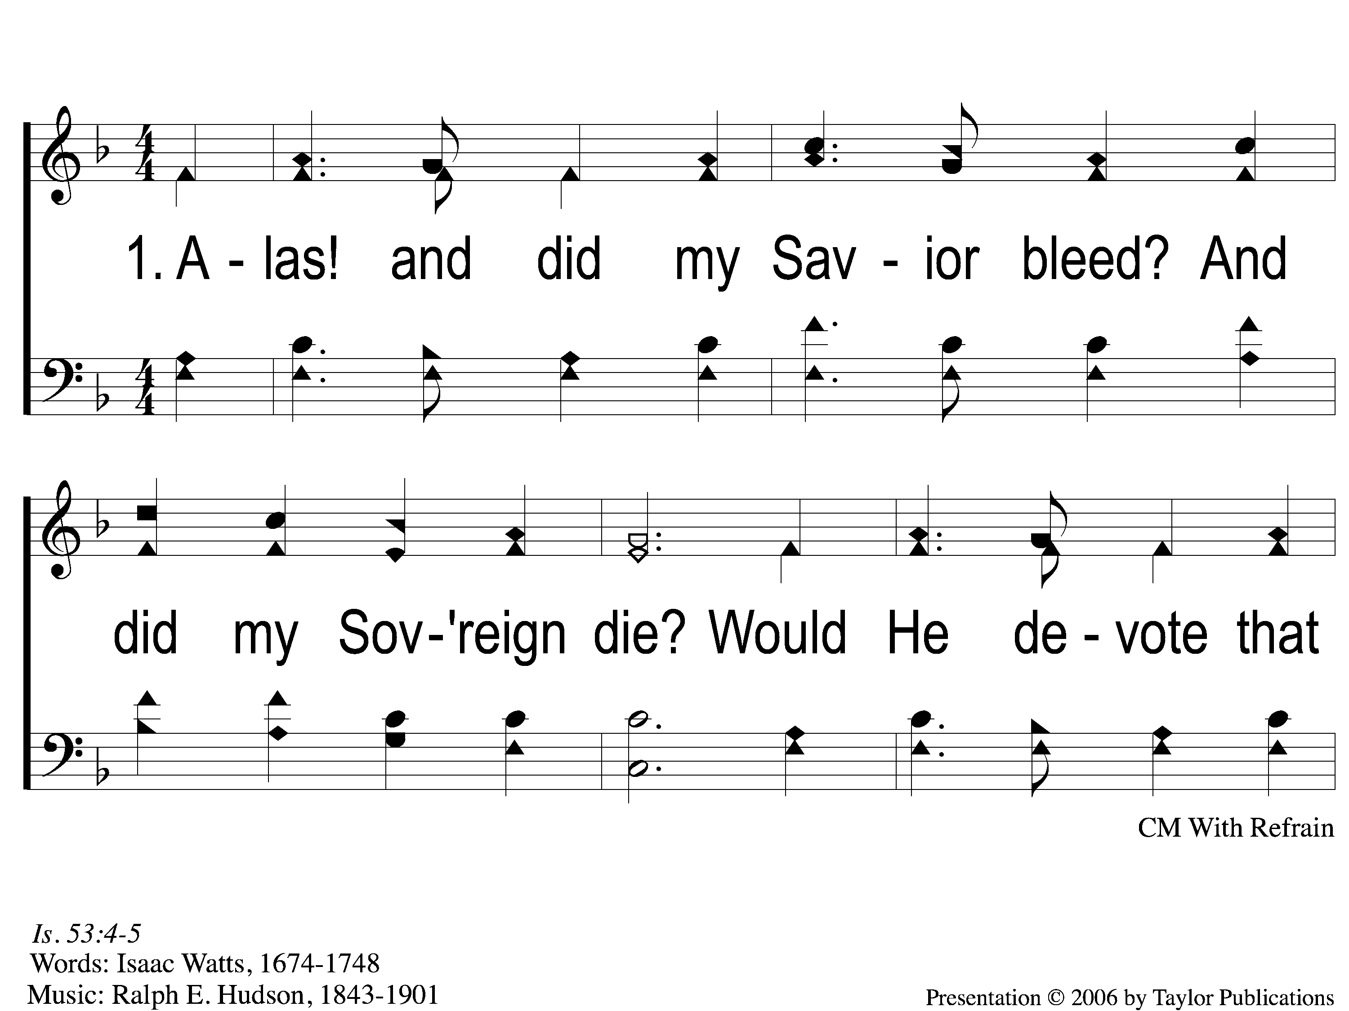
1-1 Alas and Did My Savior Bleed
Alas! And Did My Savior Bleed?
6

Slide 2
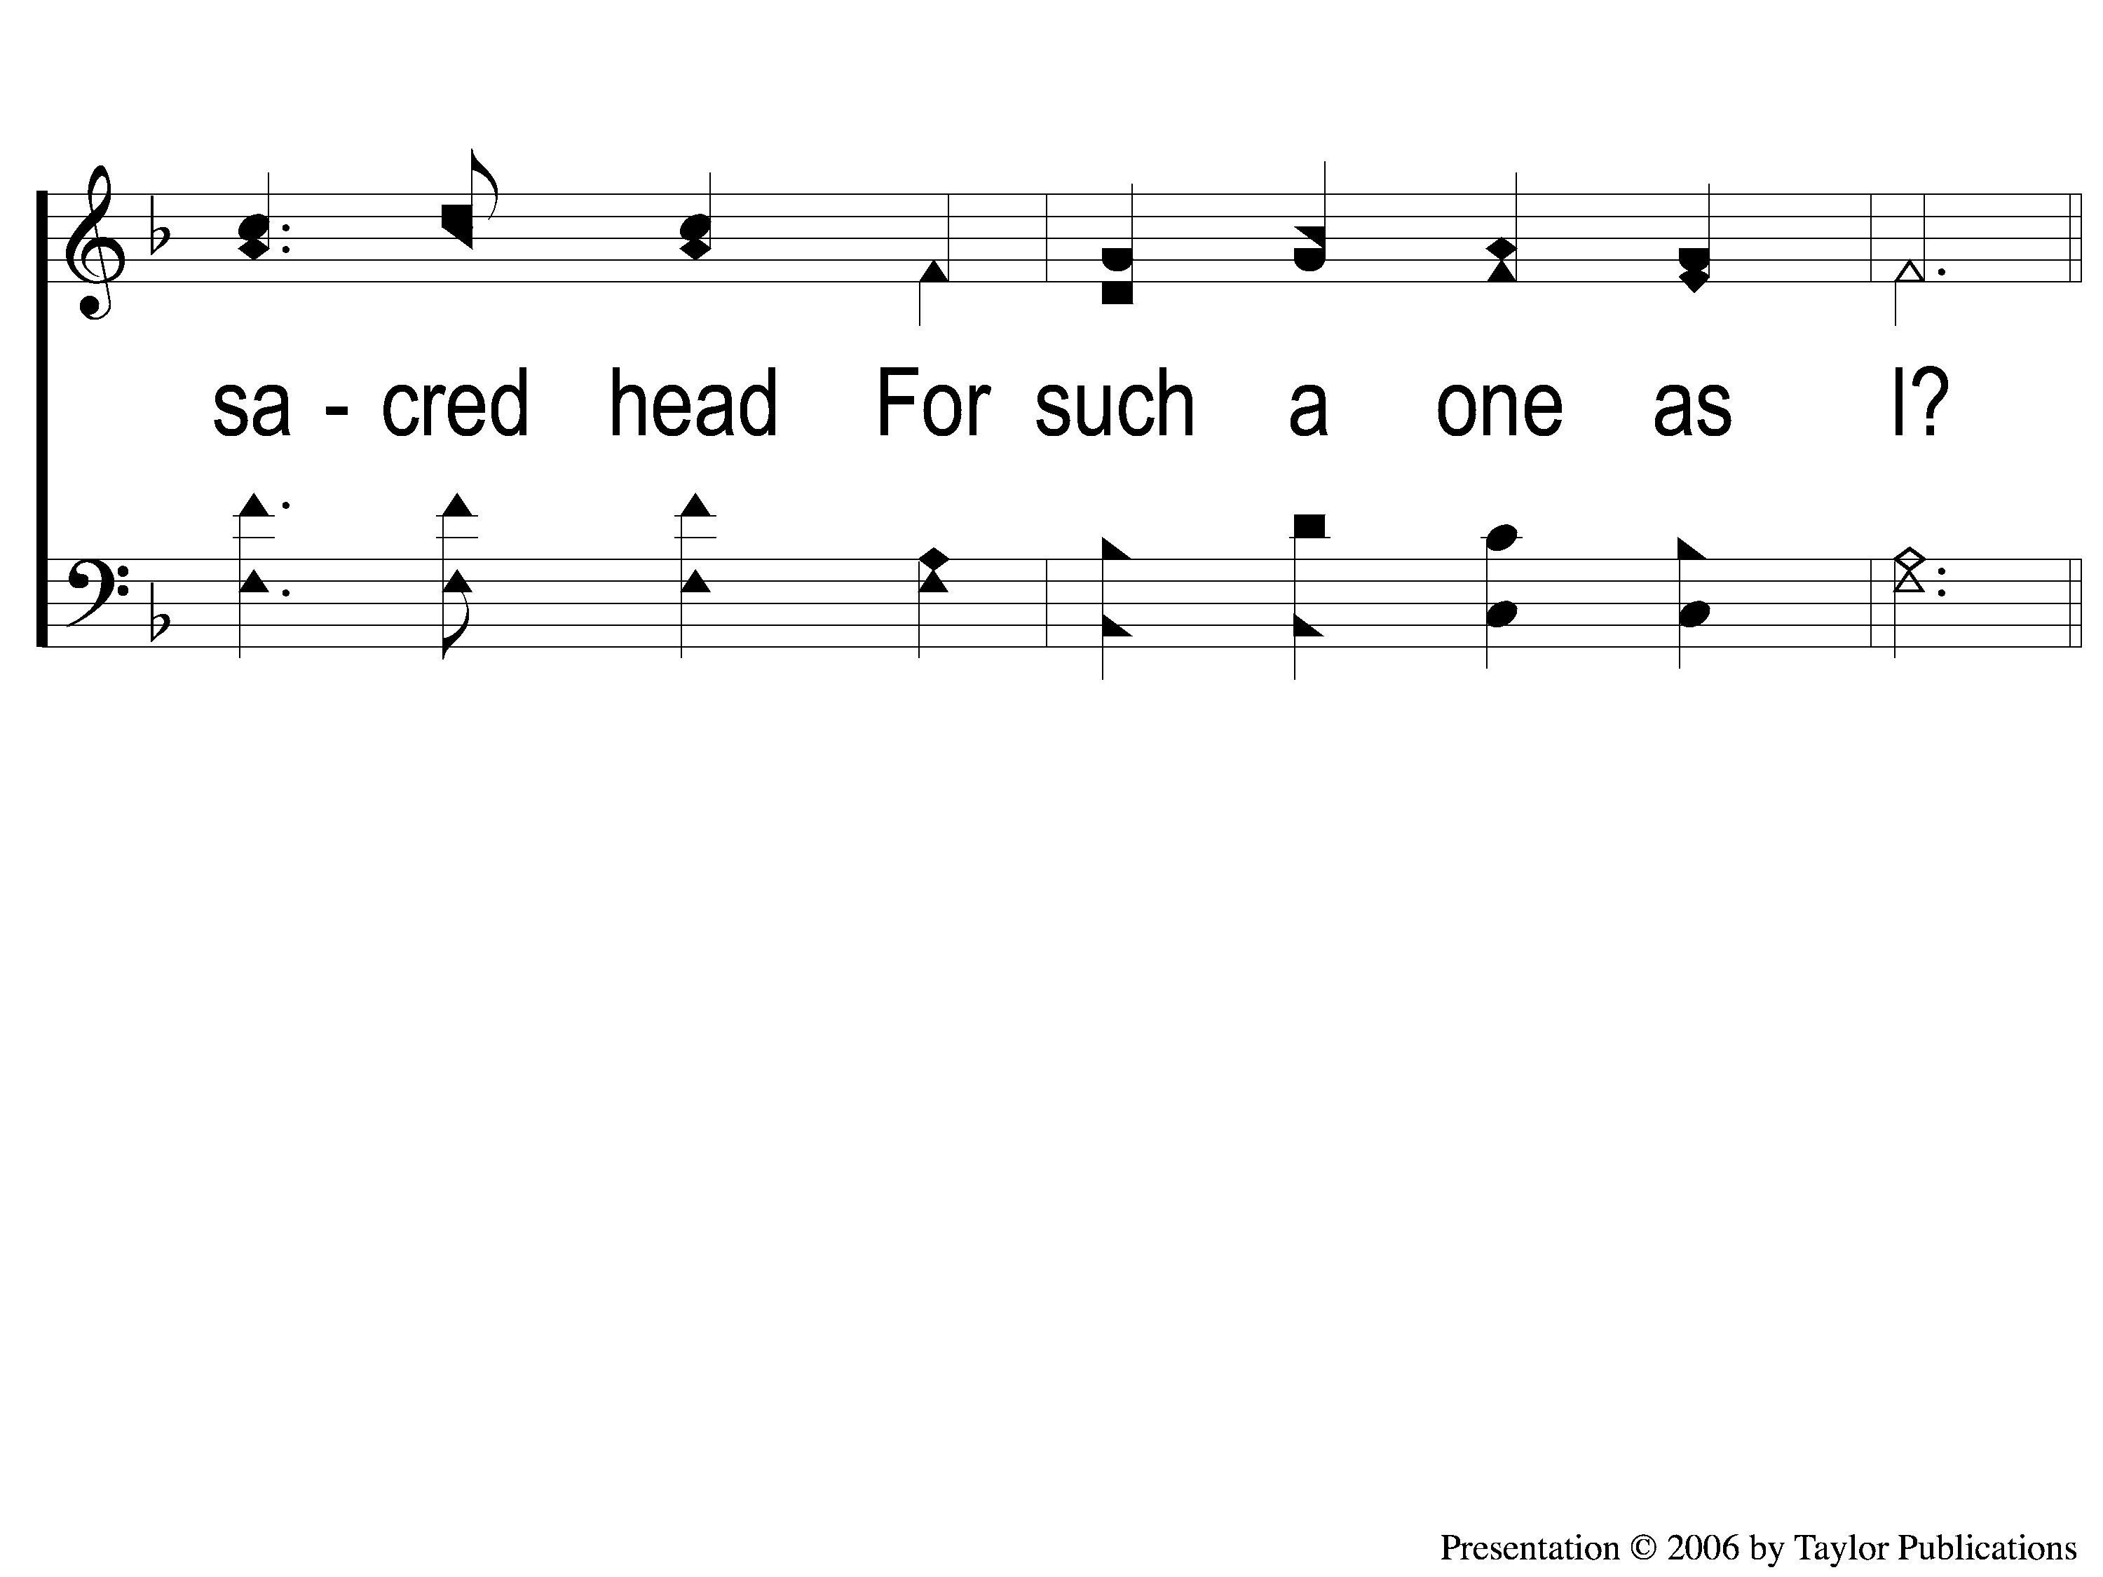
1-2 Alas and Did My Savior Bleed
Alas! And Did My Savior Bleed?
6

Slide 3
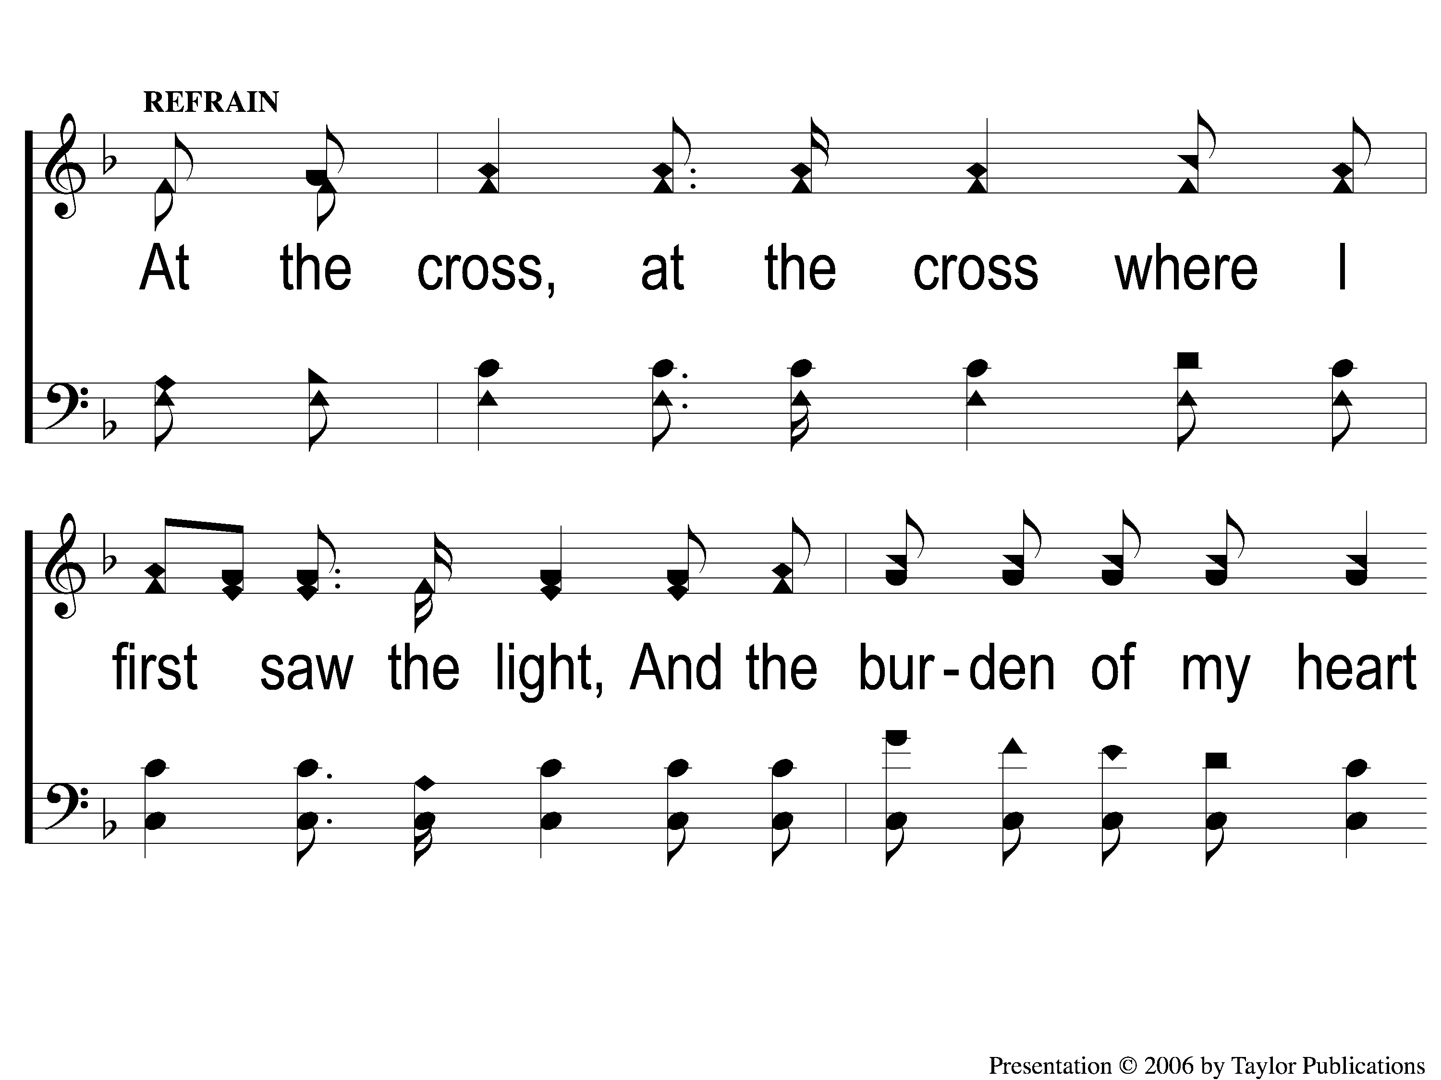
C-1 Alas and Did My Savior Bleed
Alas! And Did My Savior Bleed?
6

Slide 4
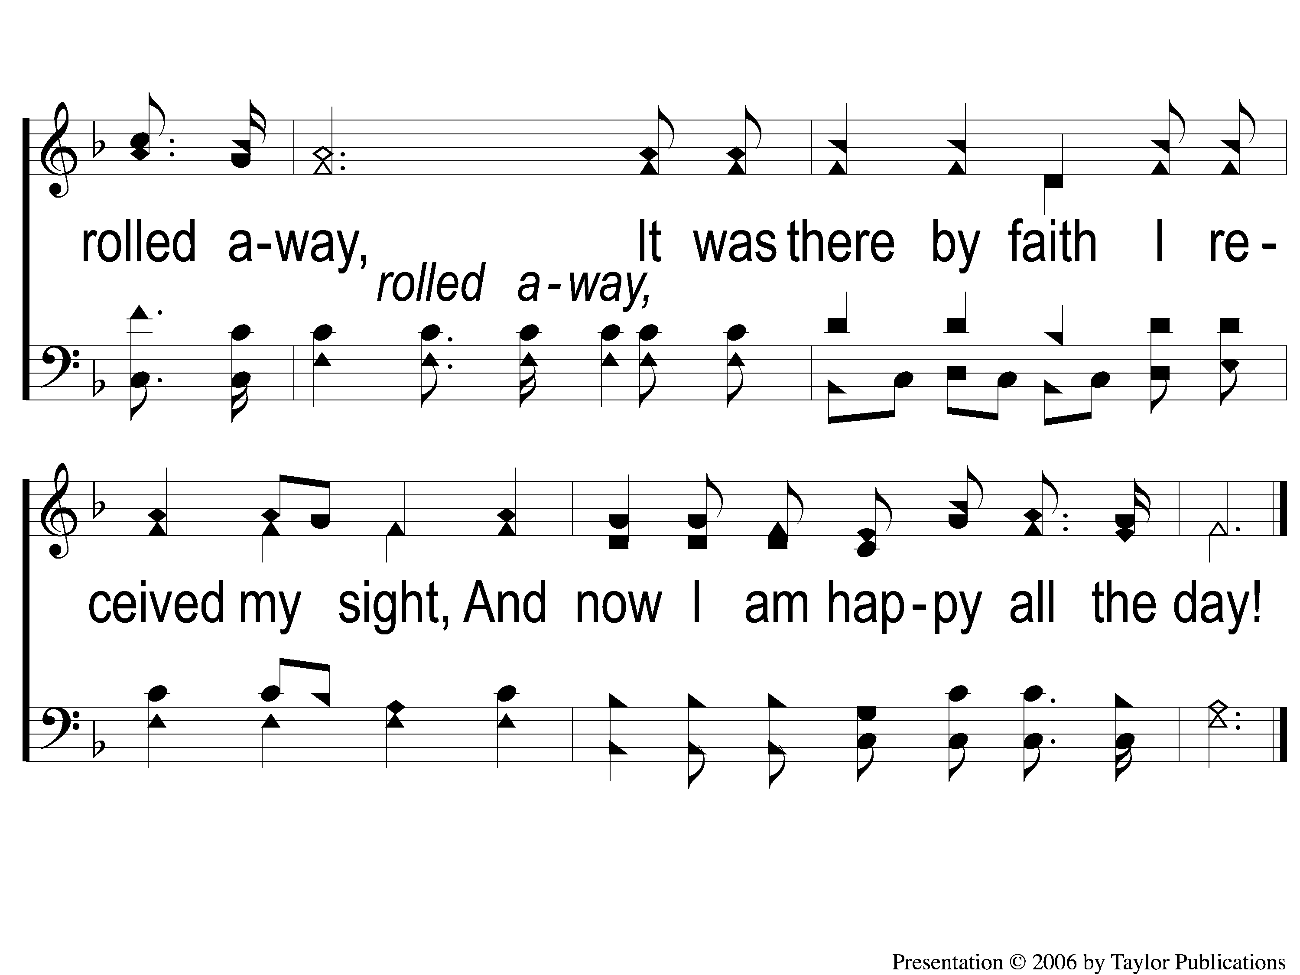
C-2 Alas and Did My Savior Bleed
Alas! And Did My Savior Bleed?
6

Slide 5
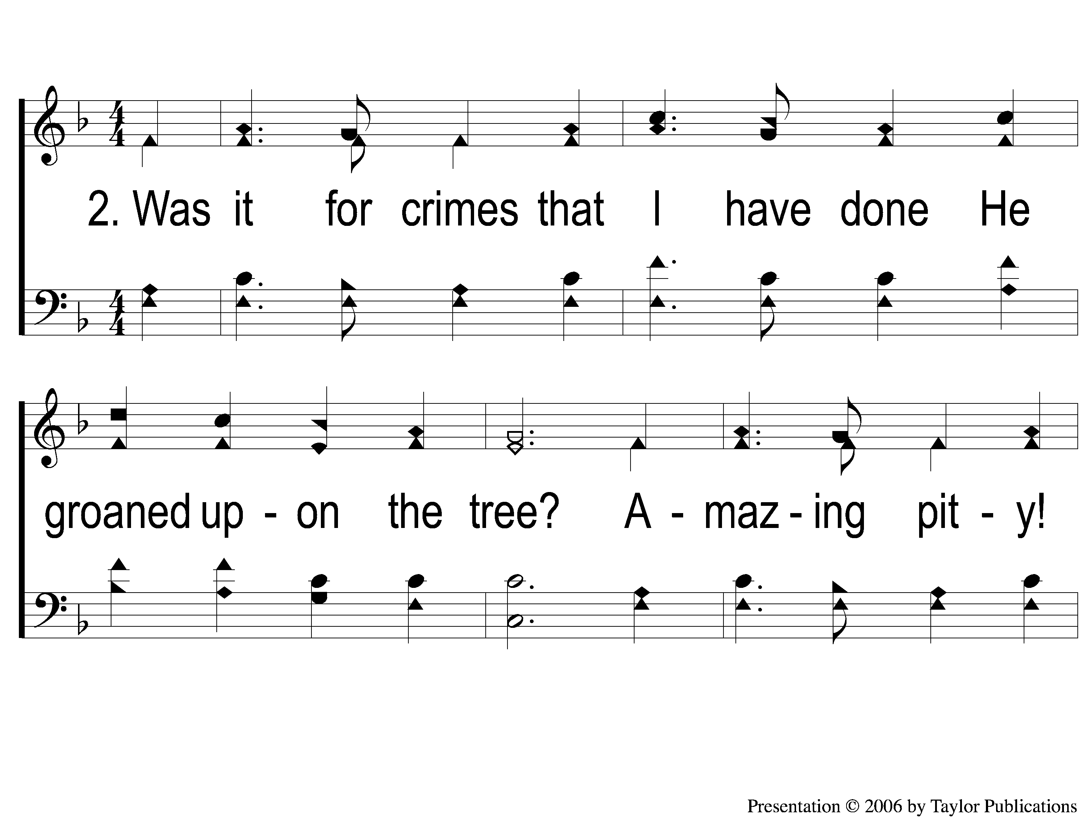
2-1 Alas and Did My Savior Bleed
Alas! And Did My Savior Bleed?
6

Slide 6
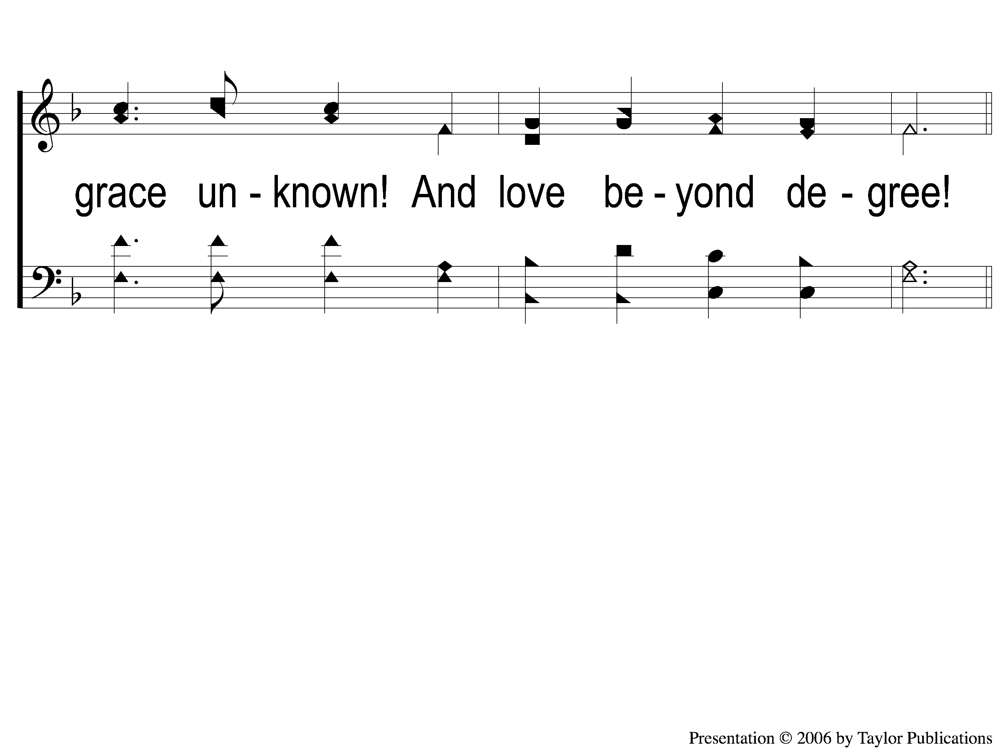
2-2 Alas and Did My Savior Bleed
Alas! And Did My Savior Bleed?
6

Slide 7
C-1 Alas and Did My Savior Bleed
Alas! And Did My Savior Bleed?
6

Slide 8
C-2 Alas and Did My Savior Bleed
Alas! And Did My Savior Bleed?
6

Slide 9
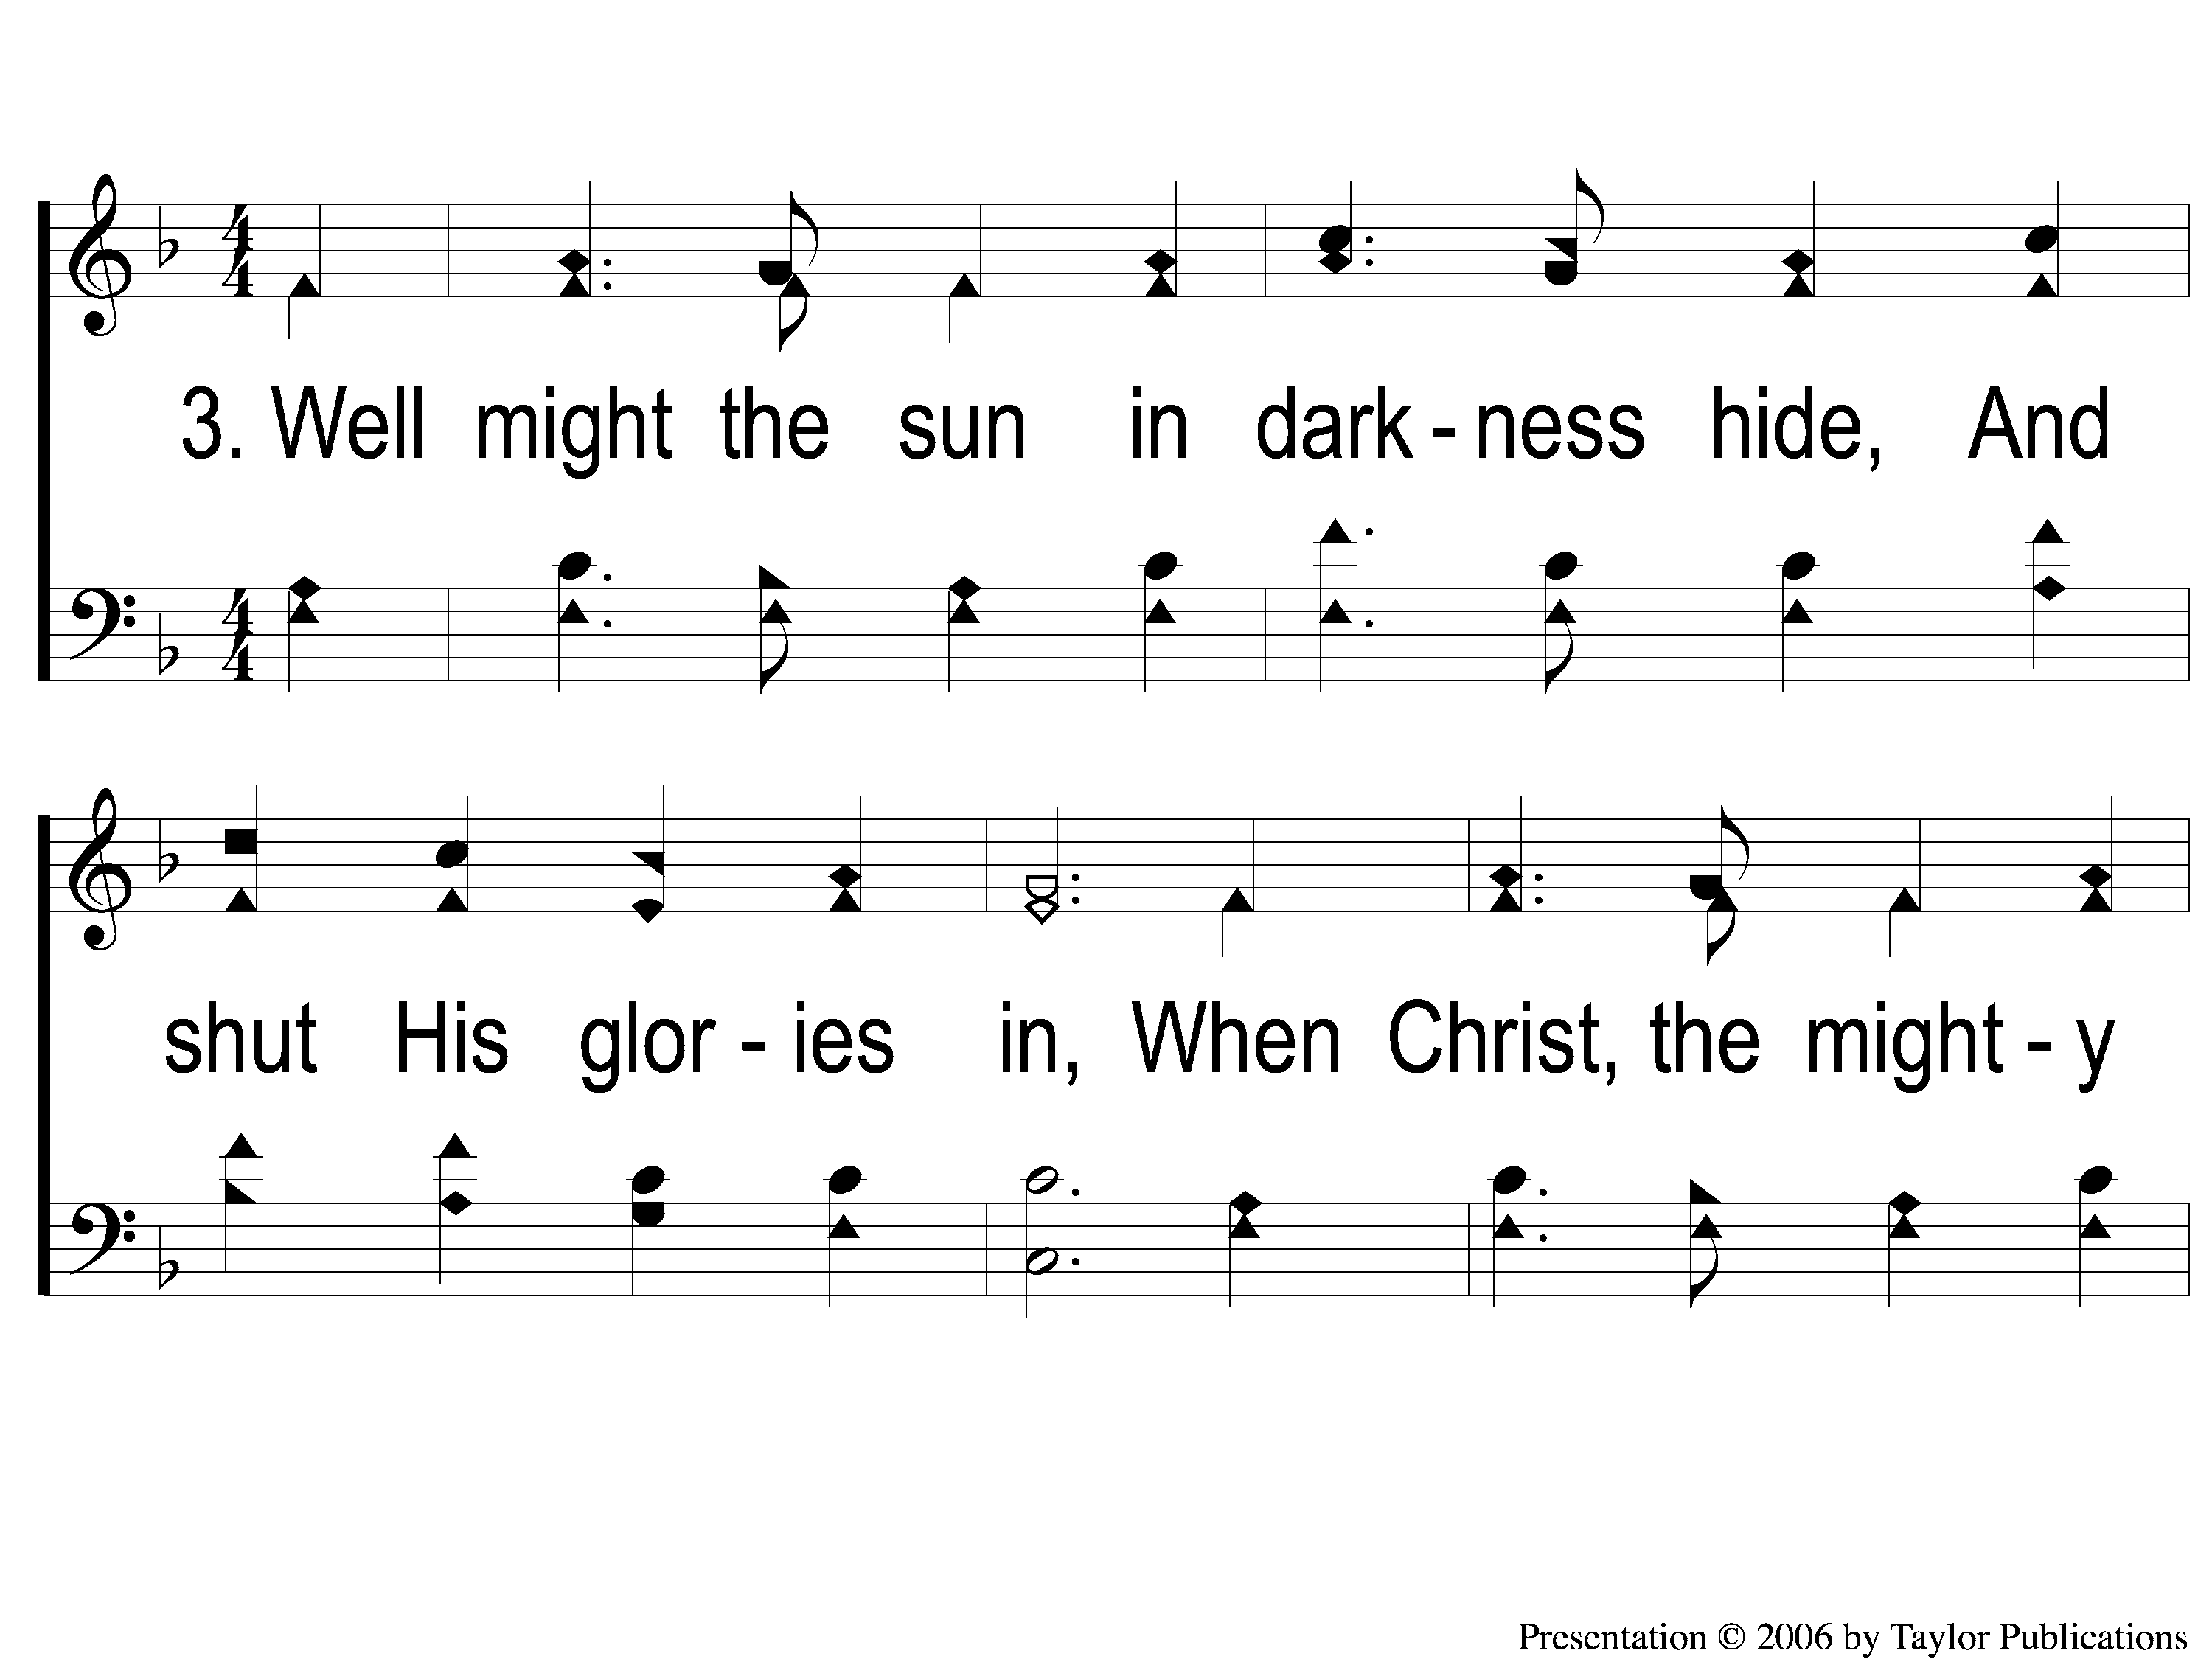
3-1 Alas and Did My Savior Bleed
Alas! And Did My Savior Bleed?
6

Slide 10
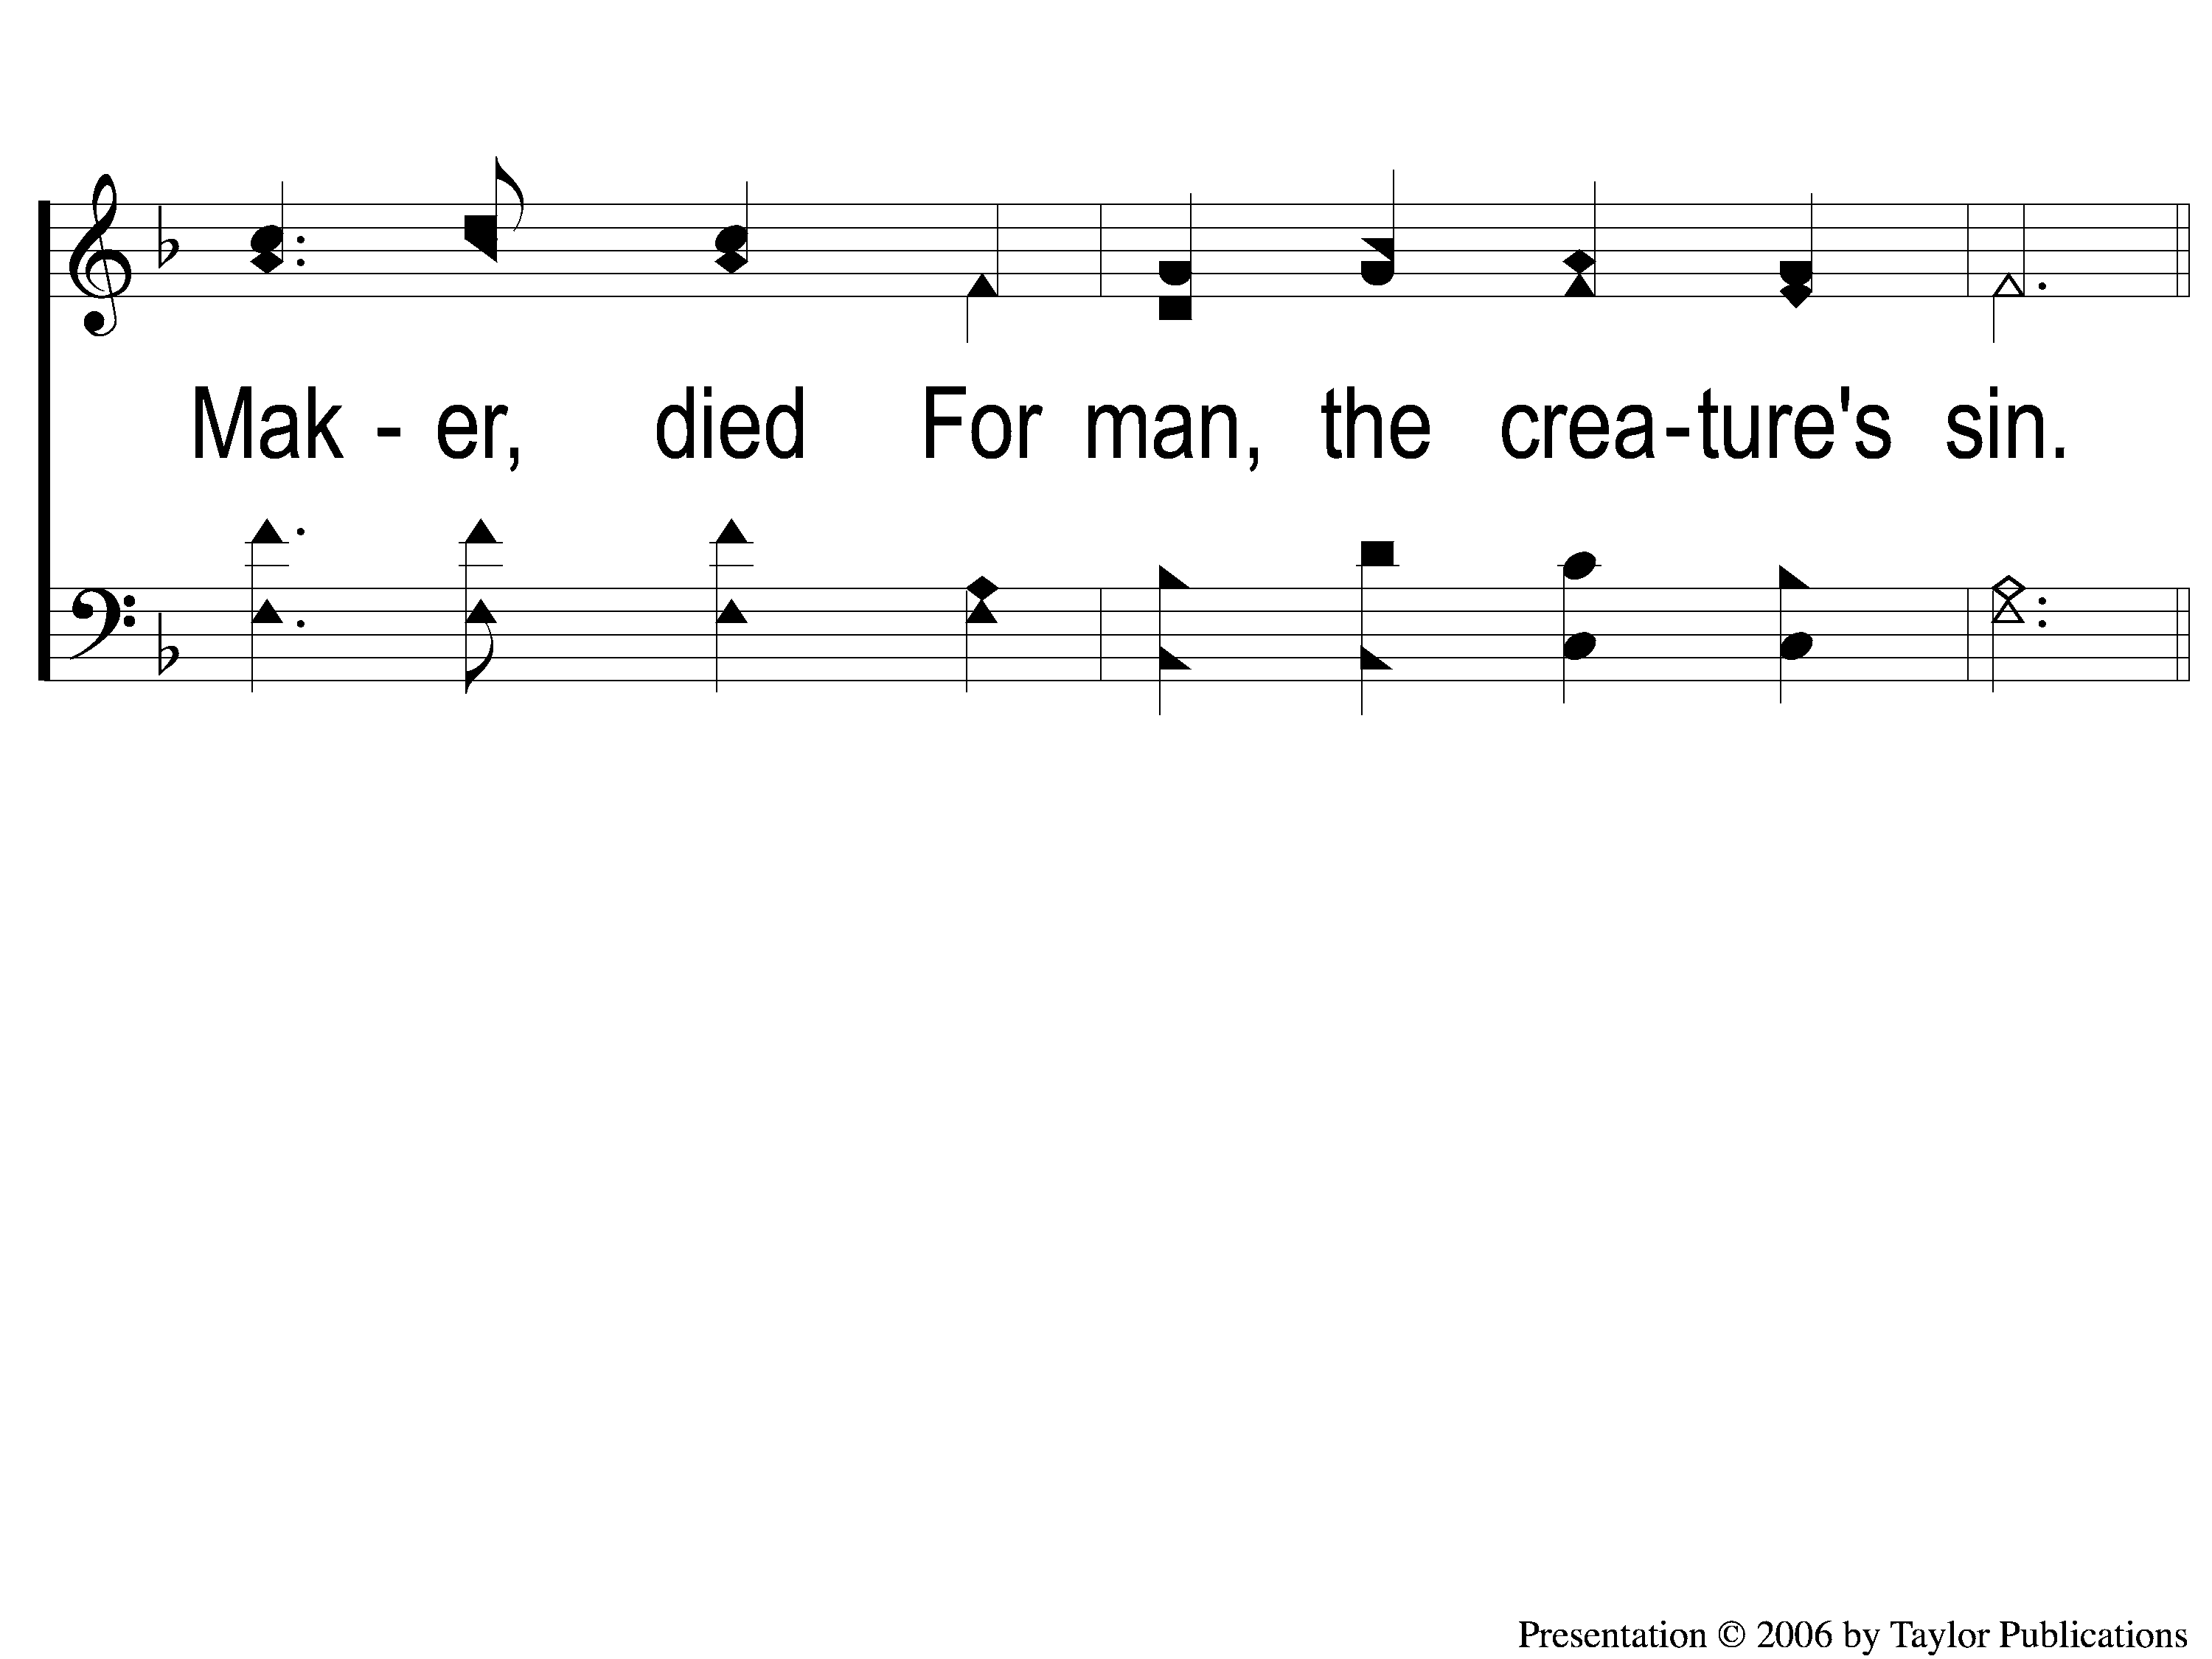
3-2 Alas and Did My Savior Bleed
Alas! And Did My Savior Bleed?
6

Slide 11
C-1 Alas and Did My Savior Bleed
Alas! And Did My Savior Bleed?
6

Slide 12
C-2 Alas and Did My Savior Bleed
Alas! And Did My Savior Bleed?
6

Slide 13
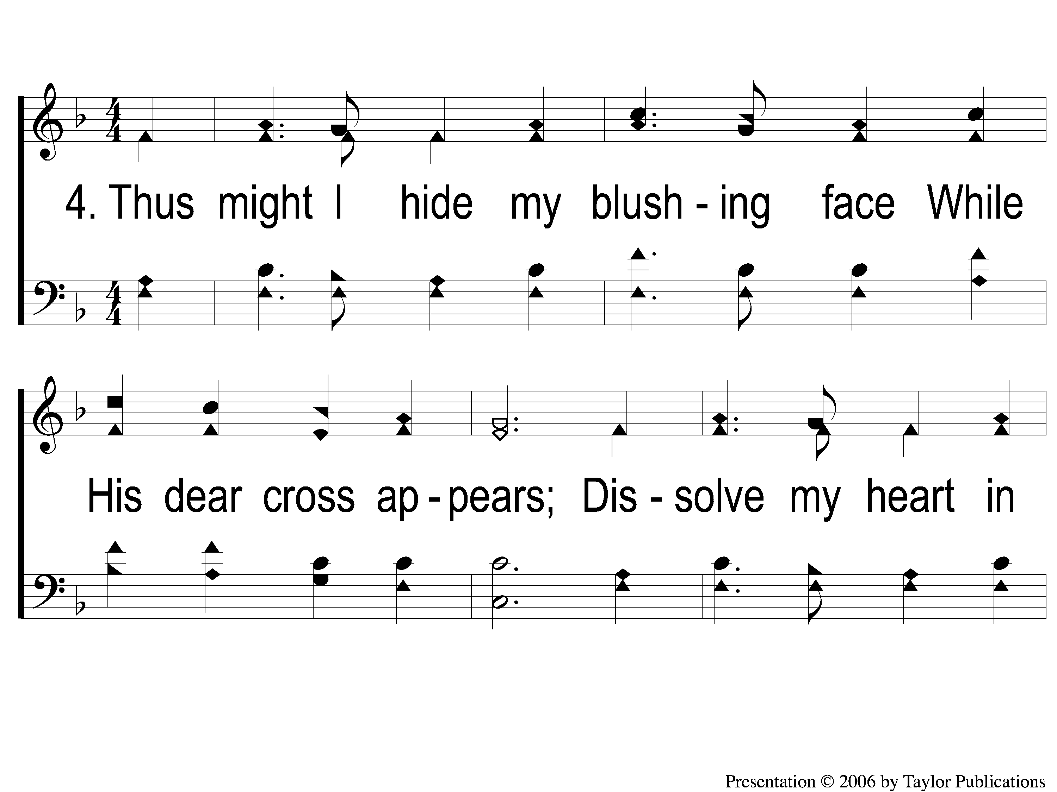
4-1 Alas and Did My Savior Bleed
Alas! And Did My Savior Bleed?
6

Slide 14
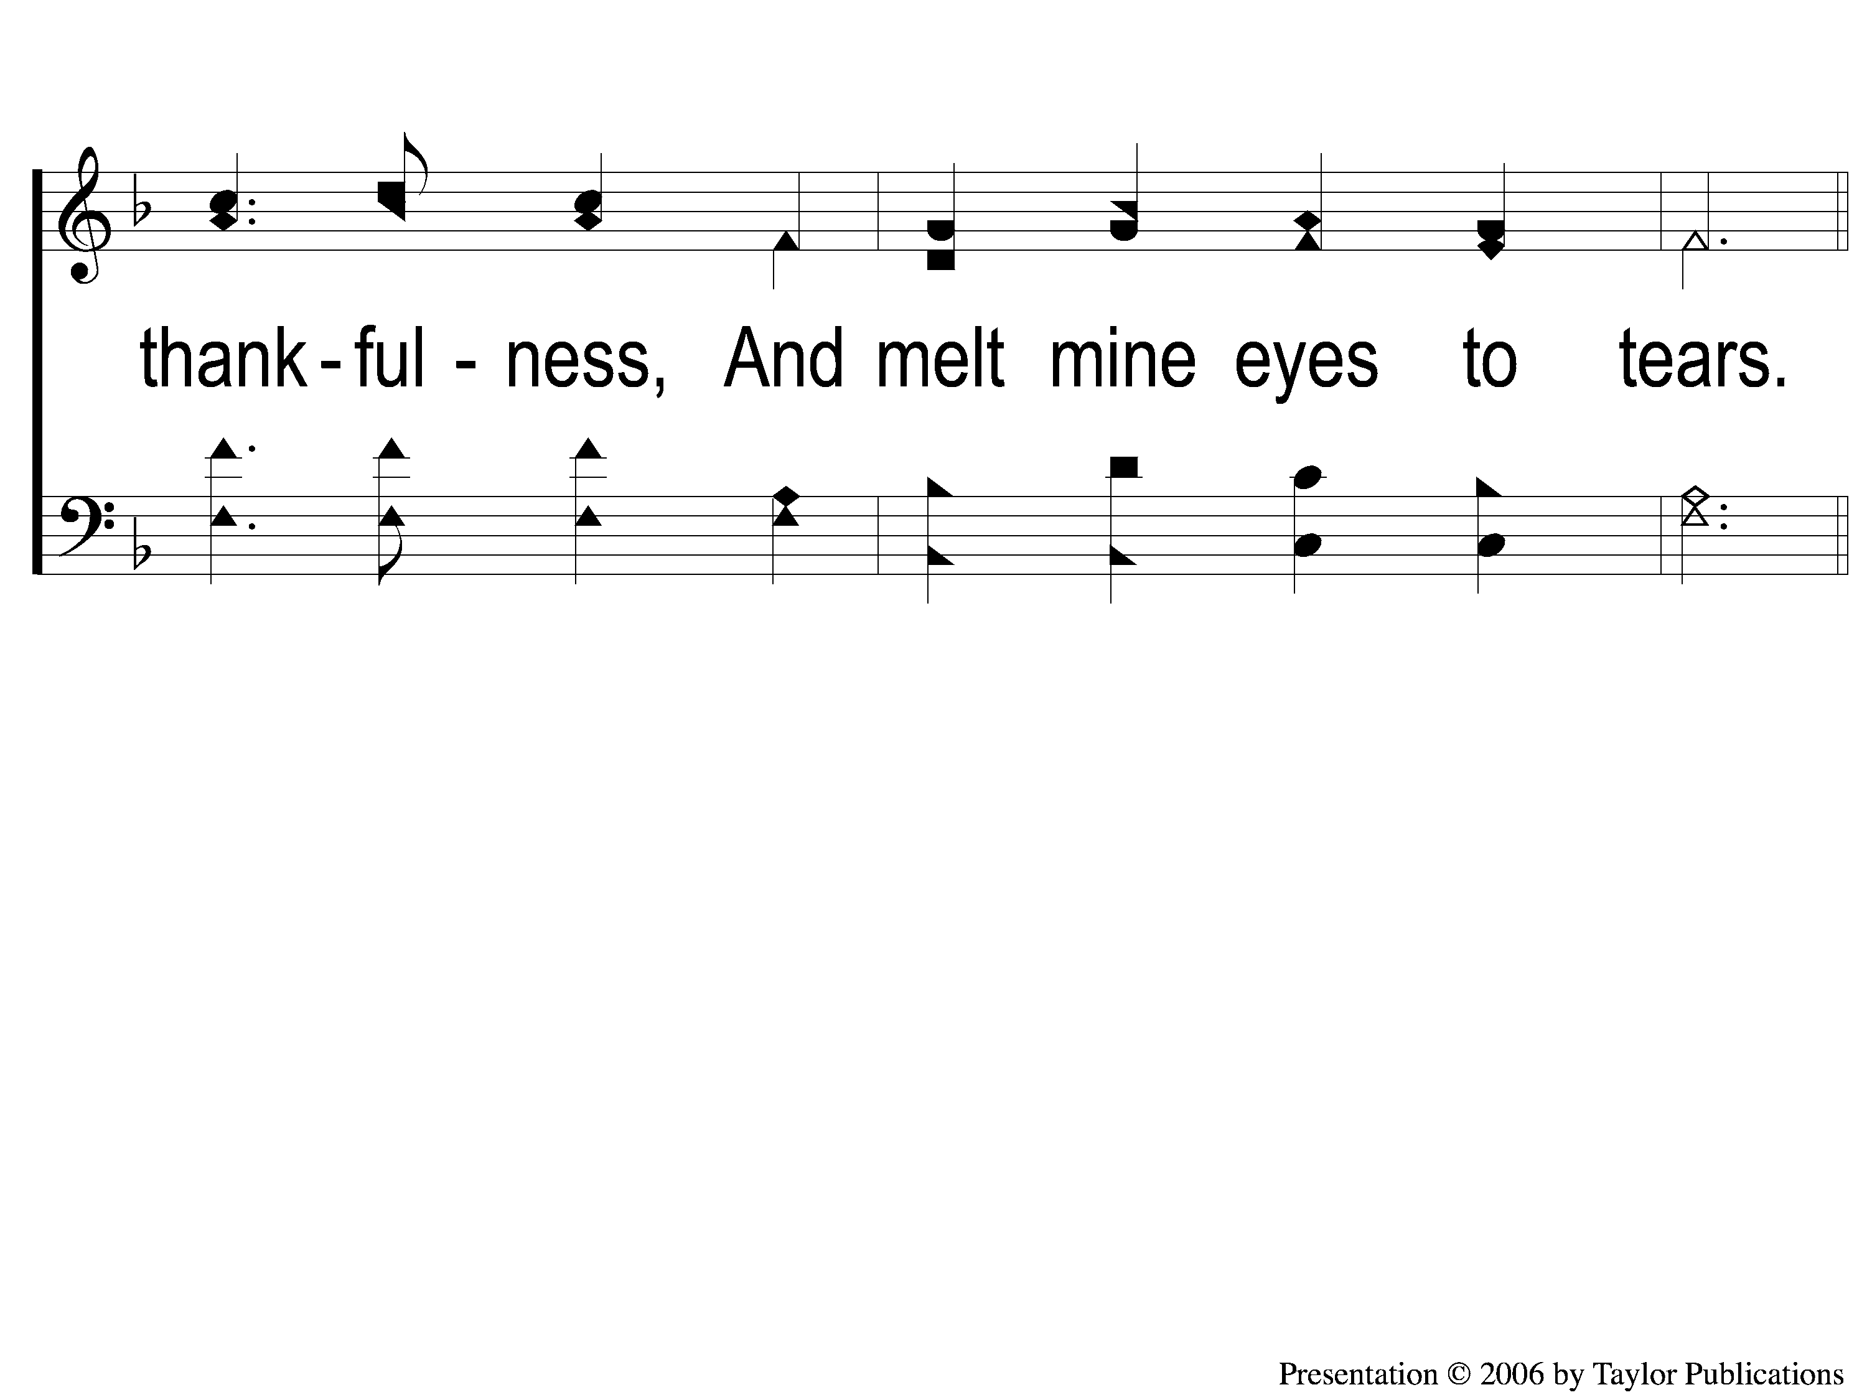
4-2 Alas and Did My Savior Bleed
Alas! And Did My Savior Bleed?
6

Slide 15
C-1 Alas and Did My Savior Bleed
Alas! And Did My Savior Bleed?
6

Slide 16
C-2 Alas and Did My Savior Bleed
Alas! And Did My Savior Bleed?
6

Slide 17
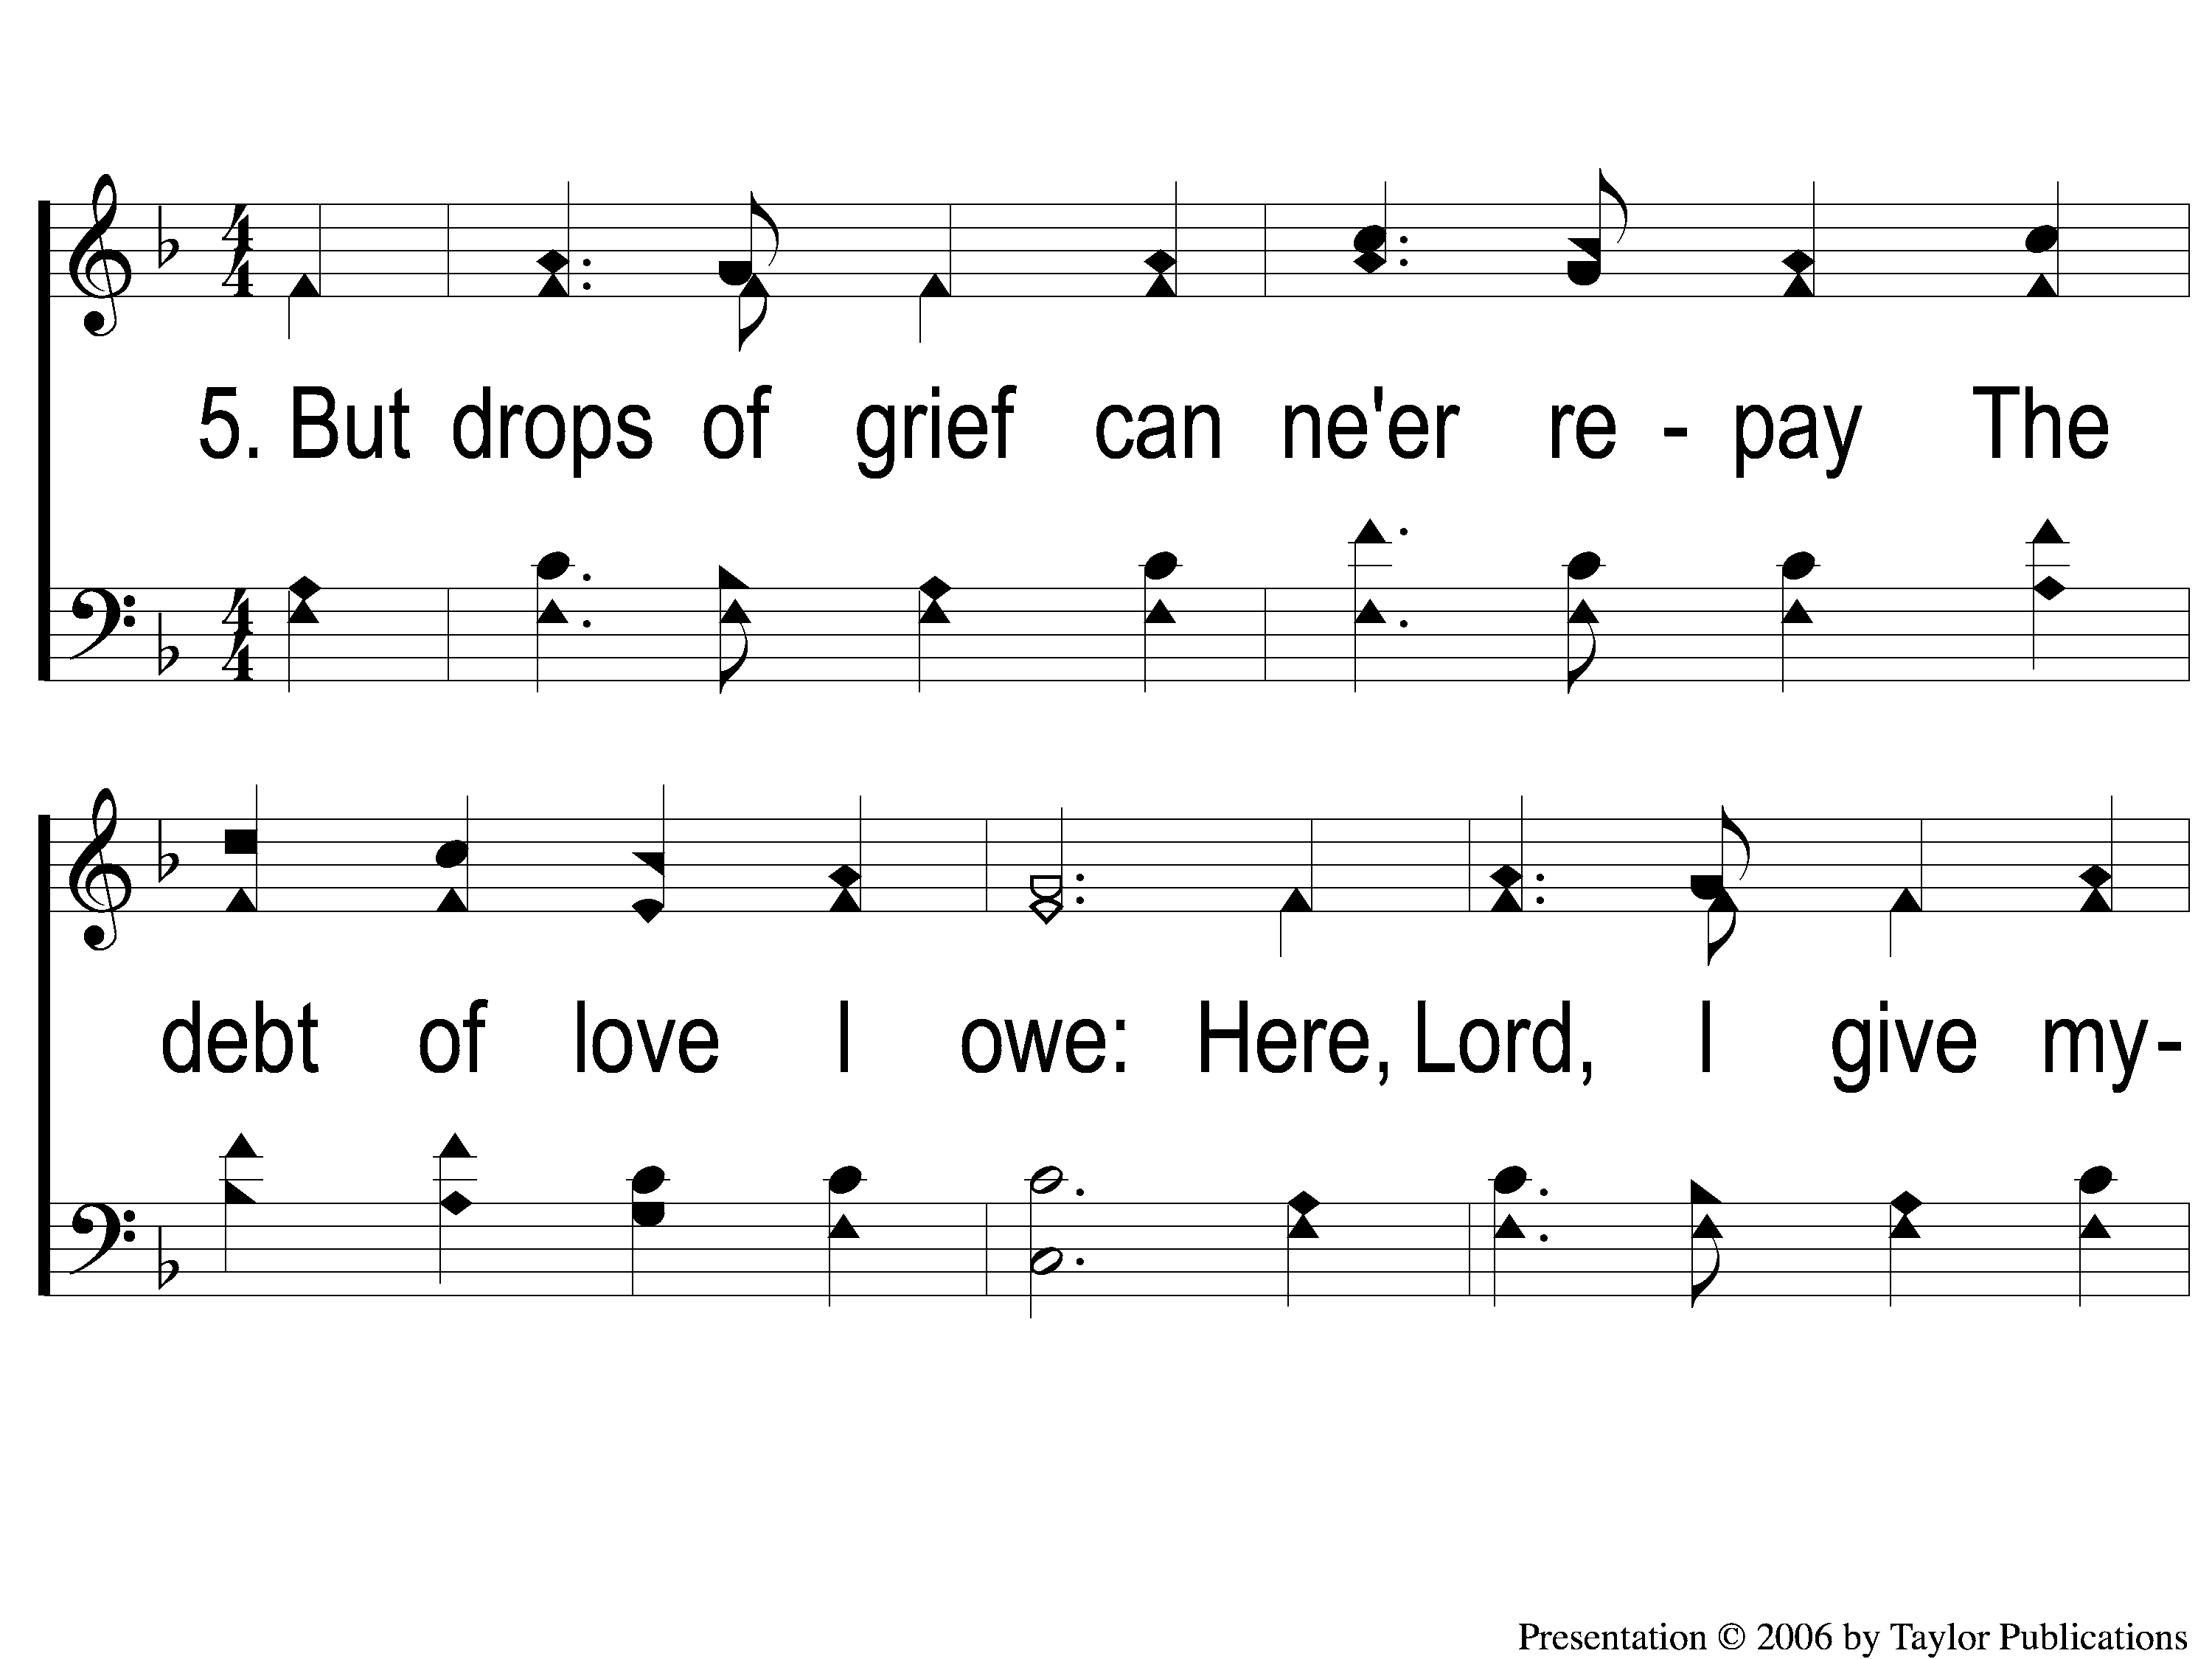
5-1 Alas and Did My Savior Bleed
Alas! And Did My Savior Bleed?
6

Slide 18
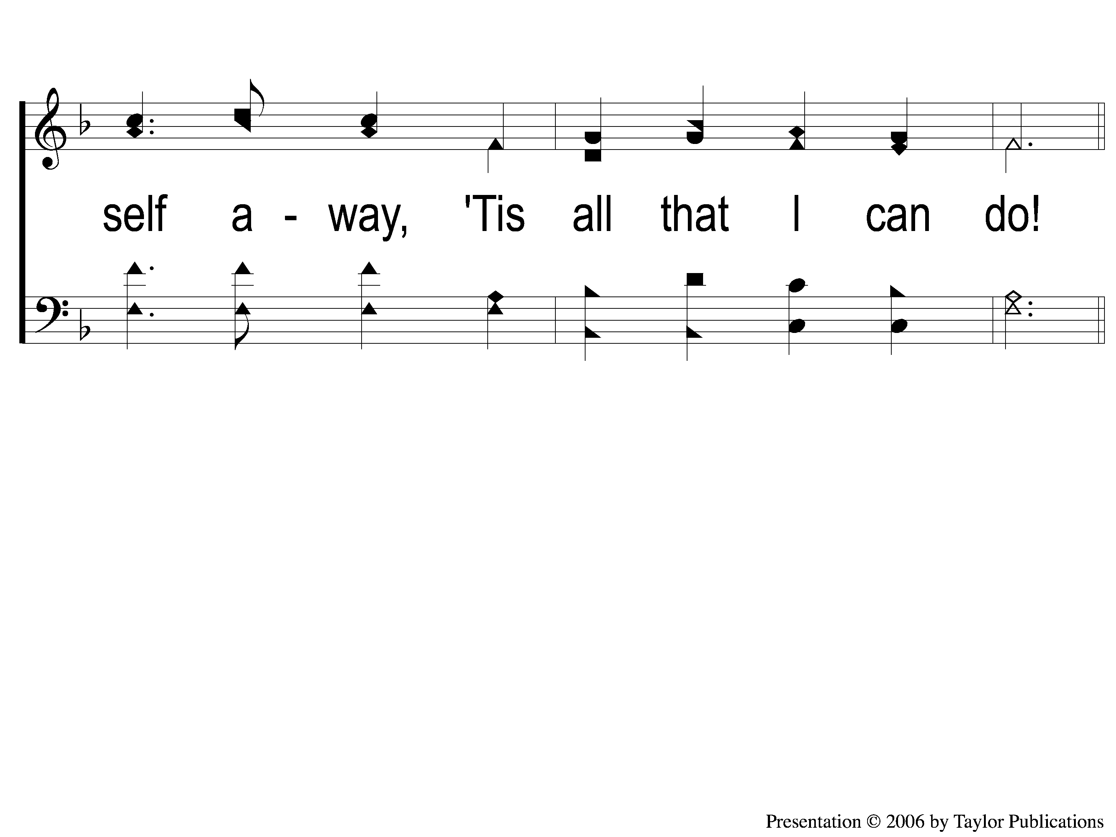
5-2 Alas and Did My Savior Bleed
Alas! And Did My Savior Bleed?
6

Slide 19
C-1 Alas and Did My Savior Bleed
Alas! And Did My Savior Bleed?
6

Slide 20
C-2 Alas and Did My Savior Bleed
Alas! And Did My Savior Bleed?
6

